Slide 1

99 Little Orange DataSet
Which customers are more likely to Churn

Slide 2
Business Overview
99 Little Orange operates a two-sided marketplace connecting drivers (supply) and passengers (demand).
The main goal of the business is to keep the marketplace balanced:
High demand, low supply → surge pricing, longer wait times and passenger dissatisfaction.
High supply, low demand → driver idle time and supply drop-off.

Slide 3
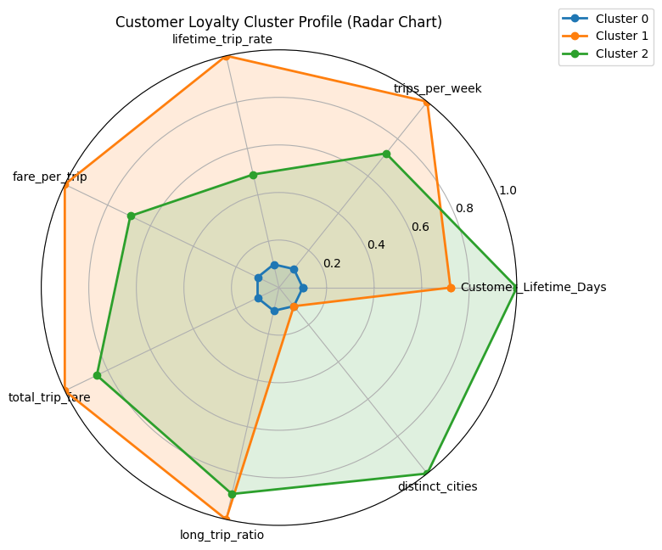
Our Clustering Findings (For Last Time)
Casual Customers (≈194k users)
Very low trip frequency
Lowest spending and shortest lifetime
These users naturally churn and are not critical for long-term retention.
Moderate-Usage Customers (≈891 users)
Highest lifetime (~306 days)
Travel across more cities on average
Healthy weekly activity and strong overall engagement
This group gives us the most stability.
High-Usage Customers (≈39k users)
High spending and strong trip frequency
Lifetime around ~282 days
Important revenue drivers and very valuable to retain.

Slide 4
Key Parameters That Drive The Dashboard
Number of clusters
Churn inactivity threshold (days)
Cluster selection
Date range

Slide 5
Our Visualization Core Concepts
Flexibility
Different types of users (analysts, managers, decision-makers) can interact with the dashboard according to their needs.
Dynamic Reflection
Every parameter change (clusters, churn threshold, date range) updates all visuals instantly.
Visuals such as radar charts, scatter plots, and KPIs simplify complex ML outputs.
Action-Driven Insights
Who is churning?
Filters, sliders, and multi-select options allow anyone to explore behavior at different levels of detail.
Users immediately see how behavior shifts without rerunning code or refreshing the environment.
Interpretability
Clusters are labeled (A, B, C…) based on business importance to make results easy to understand.
Which clusters are most valuable?
How do behavior patterns change across segments?

Slide 6
The Implementation Steps
Libraries Used:
matplotlib and seaborn for visualization
Visualization Layer:
For Clustering (K-Means):
Implemented sliders, dropdowns, multiselects, and date pickers
Marimo for dynamic modeling
Built reusable plotting functions (radar, bar/countplot, scatter)
Used custom palettes + cluster coloring to improve interpretation
KPI cards computed and displayed (churn rate, active users, cutoff date)
Visuals reflect user-selected filters (date range, clusters, features)
Every UI change triggers reactive re-execution of dependent cells
Integrated Matplotlib outputs directly inside Marimo (mo.ui.matplotlib())
Created a full analytics workflow: parameter → computation → updated visual

Slide 7
How Marimo Powers Our Interactive Dashboard
Fully Reactive Execution
Marimo automatically re-executes only the cells affected by a user’s action.
When a slider, dropdown, or date filter changes, all relevant visuals, KPIs, and tables update instantly.
Enables real-time exploration without rerunning the notebook or refreshing the interface.
Composable UI Components & Live Data Interaction
Marimo provides a rich set of widgets—sliders, multiselects, dropdowns, date pickers, buttons—allowing flexible user input.
These controls make the dashboard accessible to non-technical users while still driving complex ML operations in the background.
Every interaction (changing clusters, churn threshold, selected features, etc.) triggers immediate recalculation of metrics and charts.
Seamless Integration With Matplotlib
Although Matplotlib is a static visualization library, Marimo renders each figure cleanly and responsively inside the dashboard.
Custom Matplotlib charts—such as our radar plots, scatter plots, and countplots—are displayed through mo.ui.matplotlib(fig).
The integration allows us to keep familiar Python plotting workflows while benefiting from Marimo’s interactive layer.
The result: traditional Matplotlib visuals behave as reactive dashboard components, updating whenever filters or parameters change.

Slide 8
So, Let’s see the dasboard

Slide 9

Any Questions

Slide 10

Thank you

